Slide 1
Chapter 5
Software Requirements

Slide 2
Software Requirements
Descriptions and specifications of a system

Slide 3
Requirements engineering
The process of establishing the services that the
customer requires from a system and the constraints
under which it operates and is developed

Slide 4
Types of requirement
User requirements
  Statements in natural language plus diagrams of the services the system provides and its operational constraints. Written for customers
System requirements
  A structured document setting out detailed descriptions of the system services. Written as a contract between client and contractor
Software specification
  A detailed software description which can serve as a basis for a design or implementation. Written for developers

Slide 5
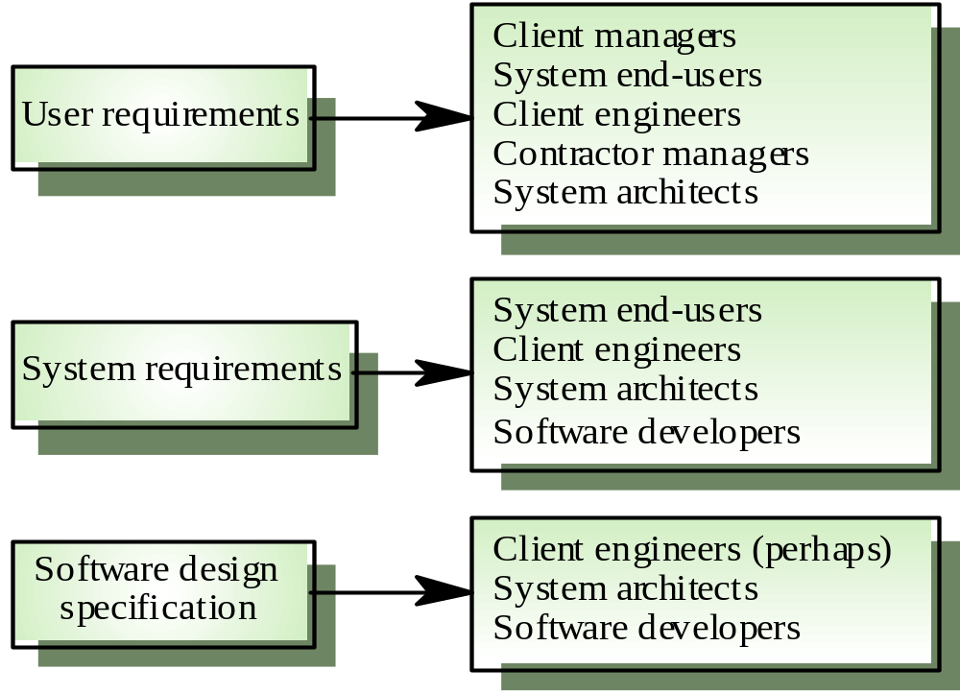
Requirements readers

Slide 6
Functional and non-functional requirements
Functional requirements
  Statements of services the system should provide, how the system should react to particular inputs and how the system should behave in particular situations.
Non-functional requirements
  constraints on the services or functions offered by the system such as timing constraints, constraints on the development process, standards, etc.
Domain requirements
  Requirements that come from the application domain of the system and that reflect characteristics of that domain

Slide 7
Functional requirements
Describe functionality or system services
Depend on the type of software, expected users and the type of system where the software is used
Functional user requirements may be high-level statements of what the system should do but functional system requirements should describe the system services in detail

Slide 8
Non-functional requirements
Define system properties and constraints e.g. reliability, response time and storage requirements. Constraints are I/O device capability, system representations, etc.
Process requirements may also be specified mandating a particular CASE system, programming language or development method
Non-functional requirements may be more critical than functional requirements. If these are not met, the system is useless

Slide 9
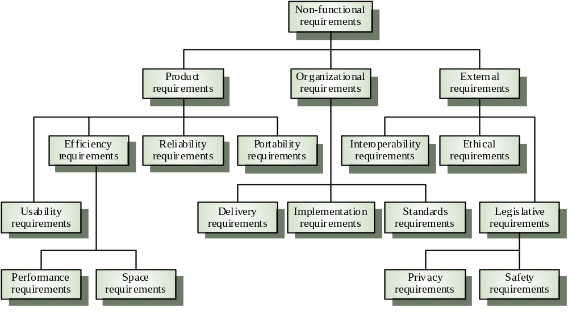
Non-functional requirement types

Slide 10
User requirements
Should describe functional and non-functional requirements so that they are understandable by system users who don’t have detailed technical knowledge
User requirements are defined using natural language, tables and diagrams

Slide 11
System requirements
More detailed specifications of user requirements
Serve as a basis for designing the system
May be used as part of the system contract
System requirements may be expressed using system models discussed in Chapter 7

Slide 12
Interface specification
Most systems must operate with other systems and the operating interfaces must be specified as part of the requirements
Three types of interface may have to be defined
  Procedural interfaces
  Data structures that are exchanged
  Data representations
Formal notations are an effective technique for interface specification

Slide 13
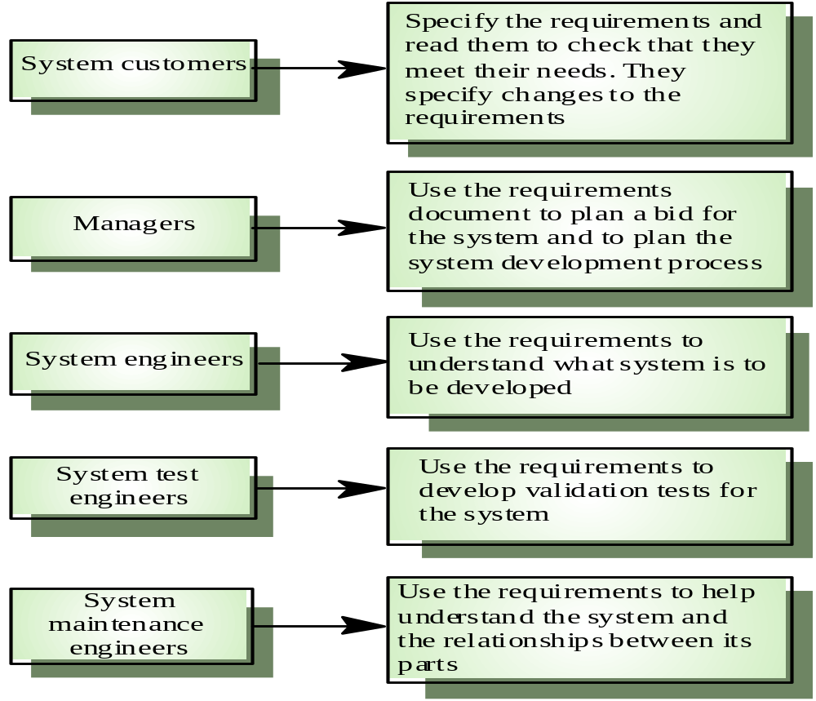
Users of a requirements document

Slide 14
Requirements document requirements
Specify external system behaviour
Specify implementation constraints
Easy to change
Serve as reference tool for maintenance
Record forethought about the life cycle of the system i.e. predict changes
Characterise responses to unexpected events

Slide 15
IEEE requirements standard
Introduction
General description
Specific requirements
Appendices
Index
This is a generic structure that must be instantiated for specific systems

Slide 16
Requirements document structure
Introduction
Glossary
User requirements definition
System architecture
System requirements specification
System models
System evolution
Appendices
Index

Slide 17
Requirements Engineering Process in Software Engineering
Feasibility Study
Requirements elicitation
Requirements specification
Requirements for verification and validation
Requirements management

Slide 18
Requirements Engineering Process in Software Engineering
Feasibility Study:
Technical Feasibility
Operational Feasibility
Economic Feasibility

Slide 19
Requirements Engineering Process in Software Engineering
Requirements Elicitation
Several techniques can be used to elicit requirements, including:
Interviews
Surveys
Focus Groups
Observation
Prototyping

Slide 20
Requirements Engineering Process in Software Engineering
Requirements Specification
Several types of requirements are commonly specified in this step, including
Functional Requirements
Non-Functional Requirements
Constraints
Acceptance Criteria

Slide 21
Requirements Engineering Process in Software Engineering
Requirements Management
Several key activities are involved in requirements management, including:
Tracking and controlling changes
Version control
Traceability
Communication
Monitoring and reporting

